Slide 1

AUTOMATIC DOOR OPENING SYSTEM BATCH NUMBER:190239 M SUMANA- 19BCE7316 SIMRAN ANAND-19BCN7072 SHARMILA RANI.CH-19BCN7020 CH.NANDINI-19BCD7018 SRAVYA.K-19BCN7197 JHANSI-19BEC7148
GUIDED BY:PROF.ABHIJIT ADHIKARI
DEPT OF CSE

Slide 2
COMPONENTS
ARDUINO UNO
PIR SENSOR
16*2 LCD
SERVO MOTOR
BREADBOARD
RESISTORS
JUMPER WIRES
CONNECTING WIRES

Slide 3
RECAP
1.)ARDUINO UNO: The Arduino Uno is an open-source microcontroller board based on the Microchi ATmega328P microcontroller and developed by Arduino.cc.
2.)PIR SENSOR: A passive infrared sensor is an electronic sensor that measures infrared light radiating from objects in its field of view.
3.)16*2 LCD:A16x2 LCD means it can display 16 characters per line and there are 2 such lines.
4.) SERVO MOTOR:A servo motor is an electrical device which can push or rotate an object with great precision.
5.)RESISTOR : Resistors are used to reduce current flow, adjust signal levels, to divide voltages, bias active elements, and terminate transmission lines.
6.)CONNECTING WIRES: Connecting wires allows an electrical current to travel from one point on a circuit to another because electricity needs a medium through which it can move.
7.)BREADBOARD:A breadboard is a solderless device for temporary prototype with electronics and test circuit designs.
8.)JUMPER WIRES : Jumper wires are simply wires that have connector pins at each end, allowing them to be used to connect two points to each other without soldering.

Slide 4
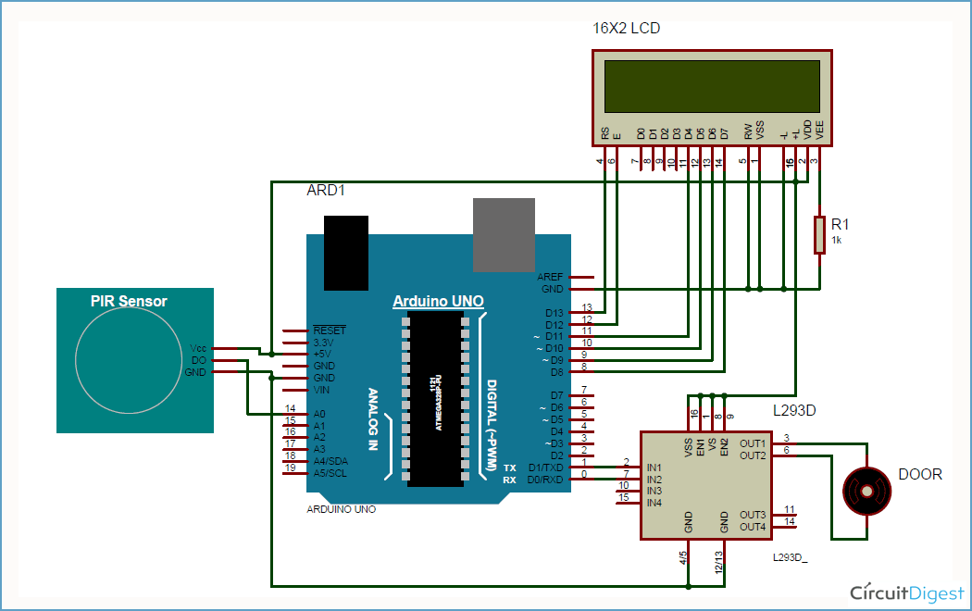
BLOCK DIAGRAM

Slide 5
COMPONENTS COST
1.)16*2 LCD | RS.130
2.)SERVO MOTOR | RS.200
3.)JUMPER WIRES | RS.60 PER SET OF 5 WIRES
4.)RESISTORS[5] | RS.40
TOTAL :- 430

Slide 6
OUR SCHEDULE UPTO CAT2
WEEK | WORK
Aug1-4 | Literature Survey
Sept 1-2 | Project based model identified
Sept 3 | Hardware analysis
Sept 4 | Coding Arduino IDE

